Slide 1
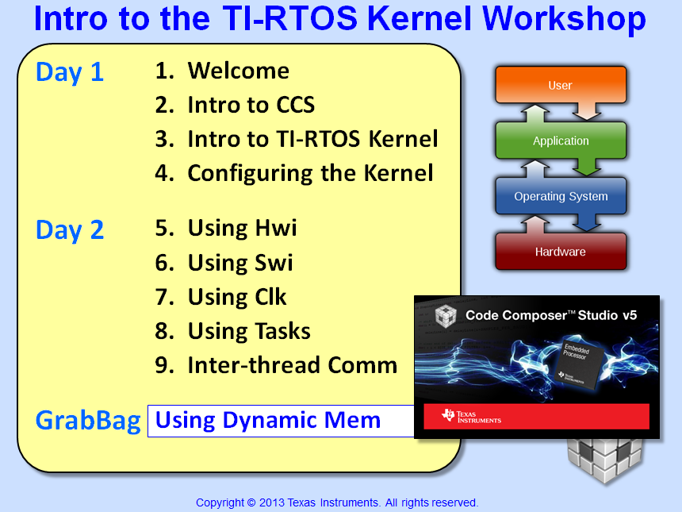

Slide 2
Objectives
Compare/contrast static and dynamic systems
Define heaps and describe how to configure the different types of heaps (std, HeapBuf, etc.)
Describe how to eliminate the drawbacks of using std heaps (fragments, non-determinism)
Implement dynamic object creation
Lab – Using the previous Task/Sem lab, create our Semaphores and Tasks dynamically

Slide 3
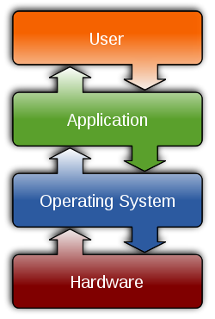

Outline
Static vs. Dynamic
Dynamic Memory Concepts
Different Types of Heaps
Dynamic Module Creation
Custom Section Placement
Lab

Slide 4
Static vs Dynamic Systems
Static Memory
Link Time: - Allocate Buffers
Execute: - Read data - Process data - Write data
Allocated at LINK time
+ Easy to manage (less thought/planning) + Smaller code size, faster startup + Deterministic, atomic (interrupts won’t mess it up)
- Fixed allocation of memory resources
Optimal when most resources needed concurrently
SYS/BIOS allows either method
Dynamic Memory (HEAP)
Create: - Allocate Buffers
Execute: - R/W & Process
Delete: - FREE Buffers
Allocated at RUN time
+ Limited resources are SHARED + Objects (buffers) can be freed back to the heap + Smaller RAM budget due to re-use
- Larger code size, more difficult to manage - NOT deterministic, NOT atomic
Optimal when multi threads share same resource or memory needs not known until runtime
Notes:
Smaller RAM budget is the result of sharing memory between two threads that run at different times. If the first allocates memory, runs, then frees this memory, a subsequent one can do the same – with the same memory. In complex systems with multiple threads, it is common that given threads only are in use some of the time. Dynamic allocation allows the system architect to take advantage of this fact and specify a RAM capacity smaller than the sum of the total RAM requirements, based on their ability to thus share the RAM.
Re-use of on-chip RAM is the same point as above, and is often a high value concern for DSP system designers.
Another technique common to RAM reuse in DSP systems is that of ‘overlays’. While this method also allows for memory reuse, it requires that the system integrator and the application authors all plan in advance how to make the overlay usage work correctly. Since this is not often possible, this is why the techniques shown here offer additional value – they allow threads to be written without knowing about other threads in the system and the benefits to still be had – reliably.

Slide 5



BIOS → Runtime Cfg – Dynamic Memory
Memory Policies – Dynamic or Static?
Dynamic is the default policy (recommended)
Static policy can save some code/data memory
Select via .CFG GUI:
MAU – Minimum Addressable Unit
Memory allocation sizes are measured in MAUs
8 bits: C6000, MSP430, ARM
16 bits: C28x
Notes:
Static builds the smallest library – but not by much. If you are trying to squeeze the last ounce of memory space and you absolutely don’t need ANY dynamic creation/deletion, well, then static might be an option. This option is probably used more on MSP430 devices – but even then, it doesn’t save that much. One way to test the savings is to build with each policy and check the memory sizes produced.

Slide 6
Outline
Static vs. Dynamic
Dynamic Memory Concepts
Using Dynamic Memory
Creating A Heap
Different Types of Heaps
Dynamic Module Creation
Custom Section Placement
Lab

Slide 7
Outline
Static vs. Dynamic
Dynamic Memory Concepts
Using Dynamic Memory
Creating A Heap
Different Types of Heaps
Dynamic Module Creation
Custom Section Placement
Lab

Slide 8
Dynamic Memory Usage (Heap)
Using Memory Efficiently
Program Cache
Common memory reuse within C language
A Heap (i.e. system memory) allocates, then frees chunks of memory from a common system block
Internal
SRAM
External Memory
CPU
Stack
EMIF
Heap
Data Cache
Code Example…

Slide 9
Dynamic Example (Heap)
“Normal” (static) C Coding
“Dynamic” C Coding
#define SIZE 32
char x[SIZE]; /*allocate*/
char a[SIZE];
x={…}; /*initialize*/
a={…};
filter(…); /*execute*/
Create
Execute
Delete
#define SIZE 32
x=malloc(SIZE); // MAUs
a=malloc(SIZE); // MAUs
x={…};
a={…};
filter(…);
free(x);
free(a);
High-performance DSP users have traditionally used static embedded systems
As DSPs and compilers have improved, the benefits of dynamic systems often allow enhanced flexibility (more threads) at lower costs

Slide 10
Dynamic Memory (Heap)
Using Memory Efficiently
Program Cache
Common memory reuse within C language
A Heap (i.e. system memory) allocates, then frees chunks of memory from a common system block
Internal
SRAM
External Memory
CPU
Stack
EMIF
Heap
Data Cache
What if I need two heaps?
Say, a big image array off-chip, and
Fast scratch memory heap on-chip?

Slide 11
Multiple Heaps
BIOS enables multiple heaps to be created
Create and name heaps in .CFG file or via C code
Use Memory_alloc() function to allocate memory and specify which heap
Program Cache
Internal
SRAM
External Memory
CPU
Stack
Heap2
EMIF
Heap
Data Cache

Slide 12
Memory_alloc()
Standard C syntax
Using Memory functions
#define SIZE 32
x=malloc(SIZE);
a=malloc(SIZE);
x={…};
a={…};
filter(…);
free(a);
free(x);
#define SIZE 32
x = Memory_alloc(NULL, SIZE, align, &eb);
a = Memory_alloc(myHeap, SIZE, align, &eb);
x = {…};
a = {…};
filter(…);
Memory_free(NULL,x,SIZE);
Memory_free(myHeap,a,SIZE);
Default System Heap
Custom heap
Error Block (more details later)
Notes: - malloc(size) API is translated to Memory_alloc(NULL,size,0,&eb) in SYS/BIOS
- Memory_calloc/valloc also available

Slide 13
Outline
Static vs. Dynamic
Dynamic Memory Concepts
Using Dynamic Memory
Creating A Heap
Different Types of Heaps
Dynamic Module Creation
Custom Section Placement
Lab

Slide 14
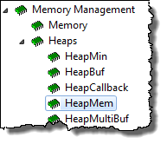
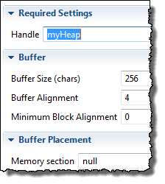
Creating A Heap (HeapMem)
1
Use HeapMem (Available Products)
2
Create HeapMem (myHeap): size, alignment, name
Static
Dynamic
HeapMem_Params_init(&prms);
prms.size = 256;
myHeap = HeapMem_create(&prms, &eb);
OR…
2^{n}
Usage
buf1 = Memory_alloc(myHeap, 64, 0, &eb)

Slide 15
Outline
Static vs. Dynamic
Dynamic Memory Concepts
Different Types of Heaps
HeapMem
HeapBuf
HeapMultiBuf
Default System Heap
Dynamic Module Creation
Custom Section Placement
Lab

Slide 16
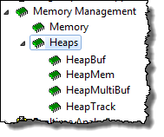
Heap Types
Users can choose from 3 different types of Heaps:
❶ HeapMem
Allocate variable-size blocks
Default system heap type
❷ HeapBuf
Allocate fixed-size blocks
❸ HeapMultiBuf
Specify variable-size blocks, but internally, allocate from a variety of fixed-size blocks

Slide 17
Outline
Static vs. Dynamic
Dynamic Memory Concepts
Different Types of Heaps
HeapMem
HeapBuf
HeapMultiBuf
Default System Heap
Dynamic Module Creation
Custom Section Placement
Lab

Slide 18
HeapMem
Most flexible – allows allocation of variable-sized blocks (like malloc())
Ideal when size of memory is not known until runtime
Creation: .CFG (static) or C code (dynamic)
Like malloc(), there are drawbacks:
HeapMem
NOT Deterministic – Memory Manager traverses linked list to find blocks
Fragmentation – After frequent allocate/free, fragments occur
Is there a heap type without these drawbacks?

Slide 19
Outline
Static vs. Dynamic
Dynamic Memory Concepts
Different Types of Heaps
HeapMem
HeapBuf
HeapMultiBuf
Default System Heap
Dynamic Module Creation
Custom Section Placement
Lab

Slide 20
HeapBuf
BUF
BUF
BUF
BUF
HeapBuf_create()
HeapBuf
HeapBuf_delete()
Memory_alloc()
Memory_free()
TSK
BUF
BUF
BUF
BUF
SWI
Allows allocation of fixed-size blocks (no fragmentation)
Deterministic, no reentrancy problems
Ideal when using a varying number of fixed-size blocks (e.g. 4-6 buffers of 64 bytes each)
Creation: .CFG (static) or C code (dynamic)
For blockSize=64: Ask for 16, get 64. Ask for 66, get NULL
How do you create a HeapBuf?

Slide 21
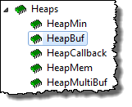

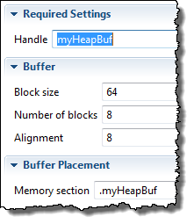
Creating A HeapBuf
1
Use HeapBuf (Available Products)
2
Create HeapBuf (myBuf): blk size, # of blocks, name
Static
Dynamic
prms.blockSize = 64;
prms.numBlocks = 8;
prms.bufSize = 256;
myHeapBuf = HeapBuf_create(&prms, &eb);
OR…
Usage
buf1 = Memory_alloc(myHeapBuf, 64, 0, &eb)
What if I need multiple sizes (16, 32, 128)?
Notes:
Warning – blocksize must be a multiple of the worst-case structure alignment size. Not sure what happens if this is NOT done.

Slide 22
Multiple HeapBufs
heapBuf1
16
16
16
16
16
16
16
16
heapBuf2
32
32
32
32
32
32
32
32
heapBuf3
128
128
1024 MAUs in 3 HeapBuf’s:
8 x 16-bytes
8 x 32-bytes
5 x 128-bytes
128
128
128
Given this configuration, what happens when we allocate the 9th 16-byte location from heapBuf1?
What “mechanism” would you want to exist to avoid the NULL return pointer?

Slide 23
Outline
Static vs. Dynamic
Dynamic Memory Concepts
Different Types of Heaps
HeapMem
HeapBuf
HeapMultiBuf
Default System Heap
Dynamic Module Creation
Custom Section Placement
Lab

Slide 24
HeapMultiBuf
16
16
16
16
16
16
16
16
32
32
32
32
32
32
32
32
128
1024 MAUs in 3 Buffers:
8 x 16-byte
8 x 32-byte
5 x 128-byte
128
128
128
128
Allows variable-size allocation from a variety of fixed-size blocks
Services requests for ANY memory size, but always returns the most efficient-sized available block
Can be configured to “block borrow” from the “next size up”
Creation: .CFG (static) or C code (dynamic)
Ask for 17, get 32. Ask for 36, get 128.
Notes:
Can be configured to “block borrow” from the “next size up”.

Slide 25
Outline
Static vs. Dynamic
Dynamic Memory Concepts
Different Types of Heaps
HeapMem
HeapBuf
HeapMultiBuf
Default System Heap
Dynamic Module Creation
Custom Section Placement
Lab

Slide 26
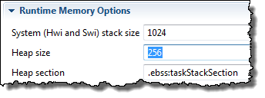
Default System Heap
BIOS automatically creates a default system heap of type HeapMem
How do you configure the default heap?
In the .CFG GUI, of course:
How to USE this heap?
align
buf1 = Memory_alloc(NULL, 128, 0, &eb);
myAlgo(buf1);
Memory_free(NULL, buf1, 128);
If NULL, uses default heap

Slide 27
Outline
Static vs. Dynamic
Dynamic Memory Concepts
Different Types of Heaps
Dynamic Module Creation
Custom Section Placement
Lab

Slide 28
Dynamically Creating SYS/BIOS Objects
Module_create
Allocates memory for object out of heap
Returns a Module_Handle to the created object
Module_delete
Frees the object’s memory
Example: Semaphore creation/deletion:
Modules
Hwi
Swi
Task
Semaphore
Stream
Mailbox
Timer
Clock
List
Event
Gate
#define COUNT 0
Semaphore_Handle hMySem;
hMySem = Semaphore_create(COUNT,NULL,&eb);
Semaphore_post(hMySem);
Semaphore_delete(&hMySem);
params
C
X
D
Note: always check return value of _create APIs !
Notes:
NULL is the Attrs structure for this creation.

Slide 29
Example – Dynamic Task API
Task_Handle hMyTsk;
Task_Params taskParams;
Task_Params_init(&taskParams);
taskParams.priority = 3;
hMyTsk = Task_create(myCode,&taskParams,&eb); // “MyTsk” now active w/priority = 3 ...
Task_delete(&hMyTsk);
C
X
D
taskParams includes: heap location, priority, stack ptr/size, environment ptr, name
Notes:
Why taskParams? It sets the defaults if you don’t. Plus, you can change those defaults (like priority above). Also, it opens up the ability for adding new features (params) in the future with the same C code.

Slide 30
What is Error Block ?
Usage
Setup Code
buf1 = Memory_alloc (myBuf, 64, 0, &eb)
Error_Block eb;
Error_init (&eb);
Most SYS/BIOS APIs that expect an error block also return a handle to the created object or allocated memory
If NULL is passed instead of an initialized Error_Block and an error occurs, the application aborts and the error can be output using System_printf().
This may be the best behavior in systems where an error is fatal and you do not want to do any error checking
The main advantage of passing and testing Error_block is that your program controls when it aborts.
Typically, systems pass Error_block and check resource pointer to see if it is NULL, then make a decision…
Can check Error_Block using: Error_check()

Slide 31
Outline
Static vs. Dynamic
Dynamic Memory Concepts
Different Types of Heaps
Dynamic Module Creation
Custom Section Placement
Lab

Slide 32
Custom Placement of Data and Code
Problem #1: You have a function or buffer that you want to place at a specific address in the memory map. How is this accomplished?
.myCode
myFxn
Mem1
.myBuf
myBuffer
Mem2
Problem #2: have two buffers, you want one to be linked at Ram1 and the other at Ram2. How do you “split” the .bss (compiler’s default) section??
.bss
buf1
Ram1
Ram2
buf1
buf2
buf2
Notes:
When you create a custom section, you must use a userlinker.cmd file and link in (-l, that’s a minus L) the linker command file generated by the cdb. This user linker command file will contain just a SECTIONS directive and the memory area you specify can be set up in the .cdb file and Mem Manager.

Slide 33
Making Custom Sections
Create custom code & data sections using:
#pragma CODE_SECTION (myFxn, “.myCode”);
void myFxn(*ptr, *ptr2, …){ };
#pragma DATA_SECTION (myBuffer, “.myBuf”);
int16_t myBuffer[32];
myFxn & myBuffer is the name of the fxn/var
“.myCode & .myBuf” are the names of the custom sections
Split default compiler section using SUB sections:
#pragma DATA_SECTION(buf1, “.bss:buf1”);
int16_t buf1[8];
#pragma DATA_SECTION(buf2, “.bss:buf2”);
int16_t buf2[8];
How do you LINK these custom sections?
Notes:
When you create a custom section, you must use a userlinker.cmd file and link in (-l, that’s a minus L) the linker command file generated by the cdb. This user linker command file will contain just a SECTIONS directive and the memory area you specify can be set up in the .cdb file and Mem Manager.

Slide 34
Linking Custom Sections
app.cmd
“Build”
app.cfg
Linker
MEMORY { … }
SECTIONS { … }
.map
SECTIONS
{ .myCode: > Mem1
.myBuf: > Mem2
.bss:buf1 > Ram1
.bss:buf2 > Ram2
}
userlinker.cmd
app.out
Create your own linker.cmd file for custom sections
CCS projects can have multiple linker CMD files
May need to create custom MEMORY segments also (device-specific)
“.bss:” used as protection against custom section not being linked
–w warns if unexpected section encountered
Notes:
Do not modify appcfg.cmd – your changes will be overwritten during “Build” (or “Rebuild”)
–mo creates subsection for every fxn (great for libraries)

Slide 35
Outline
Static vs. Dynamic
Dynamic Memory Concepts
Different Types of Heaps
Dynamic Module Creation
Custom Section Placement
Lab

Slide 36

Lab 10 – Creating Task/Sem Dynamically
main.c
Procedure
main() {
init_hw();
Timer (500ms)
BIOS_start();
}
Import archived (.zip) project (from Task lab)
Delete Task/Sem objects (for ledToggle)
Write code to create Task/Sem Dynamically
Build, “Play”, Debug
Use ROV/UIA to debug/analyze
Scheduler
Hwi
Semaphore_post(LedSem);
Hwi ISR
Task
ledToggle() {
while(1) {
Semaphore_pend(LedSem);
Toggle_LED;
}
}
ledToggleTask
Idle
Time: 30 min

Slide 37


Slide 38
Memory Footprint (MCU Targets)
Application Baseline Footprints – Non-BIOS vs. BIOS (MIN)
Application | FLASH (prog) in bytes |  |  | RAM (data) in bytes
BLINK LED Using xWare | MSP430 | C28x | Tiva-C | MSP430 | C28x(int) | Tiva-C
BASE – No BIOS (Lab 2, Blink LED) | 1658 | 1364 | 2032 | 1026 | 1313 | 1046
+ BIOS + IDLE (and IDLE fxn) | 4874 | 4034 | 12800 | 1180 | 1668 | 2162
+ Hwi | 4886 | 4370 | 12808 | 1194 | 1732 | 2194
+ Swi (incl Hwi and Swi_post) | 5790 | 4807 | 13584 | 1390 | 1796 | 2398
+ Task/Sem (incl Hwi to post Sem) | 8488 | 6507 | 16566 | 2682 | 2500 | 4742
+ UIA to Task/Sem application (default buffer sizes used) | 15520 | 9595 | 21126 | 6088 | 5706 | 8282
All BIOS applications used “MIN” BIOS CFG (modified from the BIOS U/G – Appendix D) plus whatever objects, code and stack that were necessary (projects available in TI-RTOS folder)
All applications include a 1K user (system) stack (for Hwi/Swi)
All applications used the RELEASE build configuration (for source files)
No heap (dynamic memory allocation turned off)
All BIOS builds used “custom” optimizations which is the default for BIOS libraries
Task/Idle stacks – defaults used (MSP430: 512B, C28x: 256B, TM4C: 1K)
C28x FLASH vs. RAM - .map file (FLASH = FLASH, RAM = M0-1 + L0-6), boot ROM tables excluded

Slide 39
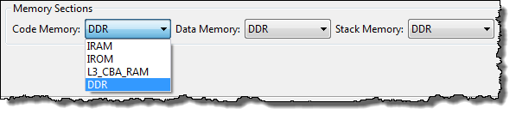
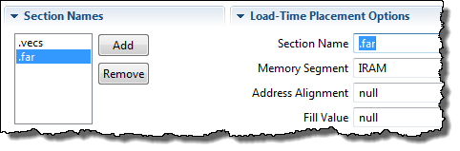

Placing a Specific Section into Memory
Via the Platform File (C6000 Only) – hi-level, but works fine:
Via the app.cfg GUI (finer control):
SYS/BIOS GUI now supports specific placements of sections (like .far, .bss, etc.) into specific memory segments (like IRAM, DDR, etc.):
GUI
CFG script

Slide 40
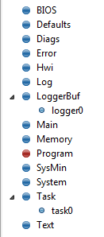
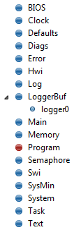
TYP vs. MIN footprints – C28x
D .text .econst .ebss
TYP 3568 1b4e 11c0
MIN 2940 4BF 752
----------------------------------------------------------------------------
Savings C28(3112) 168F(5775) A6E(2670)
SAVINGS – OVERALL
FLASH RAM TOTAL
8887 2670 11557

Slide 41
Outline
MainHighlight
MainNormal
SubHighlight
SubNormal

